Slide 1
Art Gallery
Management Database
Database Systems
By: Damian Barrous-Dume

Slide 2
Table Of Content
Abstract (Abridged)
Project Objective
Data Types Used
Data Requirements
Entity Relationship Diagram
Schema Diagram
Creating Database using MySql
Test-Case Queries
Conclusion (Abridged)
References

Slide 3
Abstract (Abridged)
The project will be creating a database for a fictional Art Gallery that they can use to manage all of the artwork they have in their system as well as those customers who purchase the artwork. The project would be a good example on how a database could improve the organization of a business such as an Art Gallery.

Slide 4
Project Objective
To create a database management system to be used by Art Galleries so that they can manage important information that pertains to them including Employees, Customers, Artwork, Artists and the Gallery itself.

Slide 5
Data Types
Integer (INT) - Can contain any whole number ranging from -2147483648 to 2147483647.
Decimal (FLOAT) - Can contain any decimal number precisely to 23 digits.
String (VARCHAR) - Can contain any alphanumeric string from a length of 0 - 255 characters/numbers.
String (TEXT) - Can contain any string from a length of 0 - 65535 characters.
Calendar Date (DATE) - Contains a calendar date in the format of YYYY-MM-DD.
Used

Slide 6
Data Requirement
Entities:
Gallery
Artwork
Artist
Customer
Employee
B.R + Cardinality:
One and only one Gallery displays at least one to many Artwork (1:M)
At least one to many Employees works for one and only one Gallery (M:1)
One and only one Artwork may have zero to one Customers (1:1)
One and only one Artists may have at least one to many Artwork (1:M)
Entities
&
Business Rules + Cardinality

Slide 7
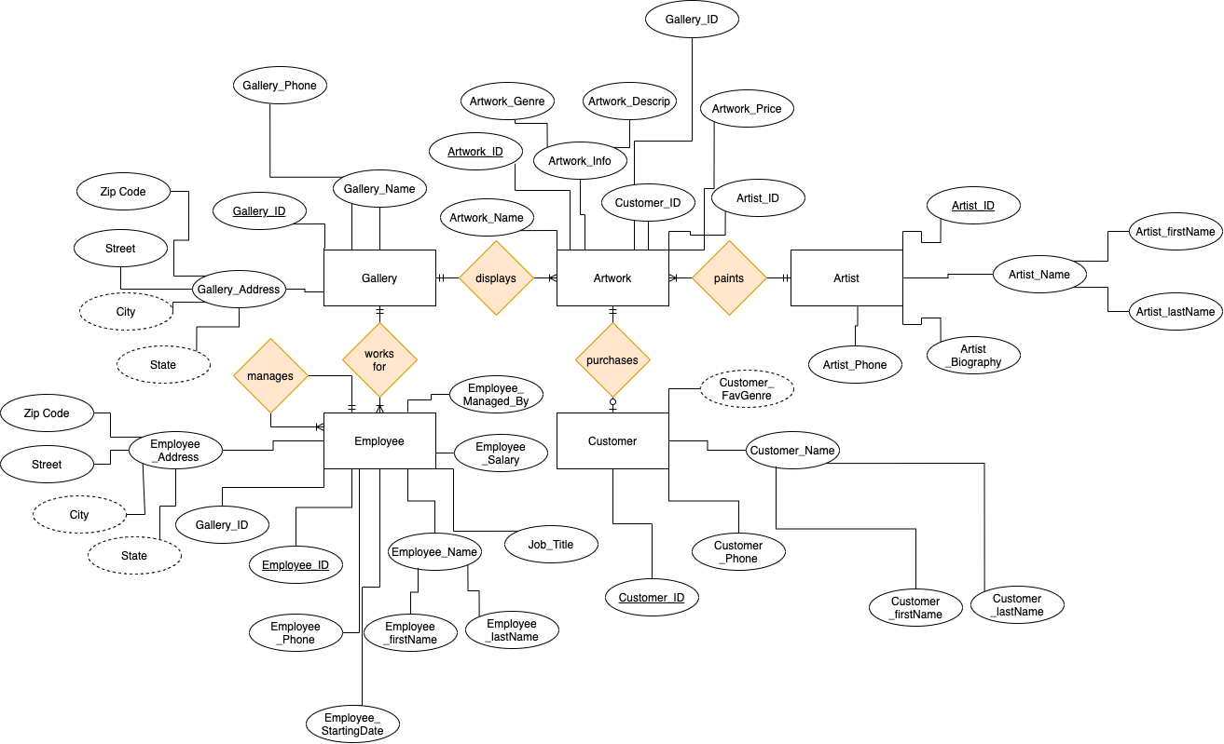
Entity Relation Diagram

Slide 8
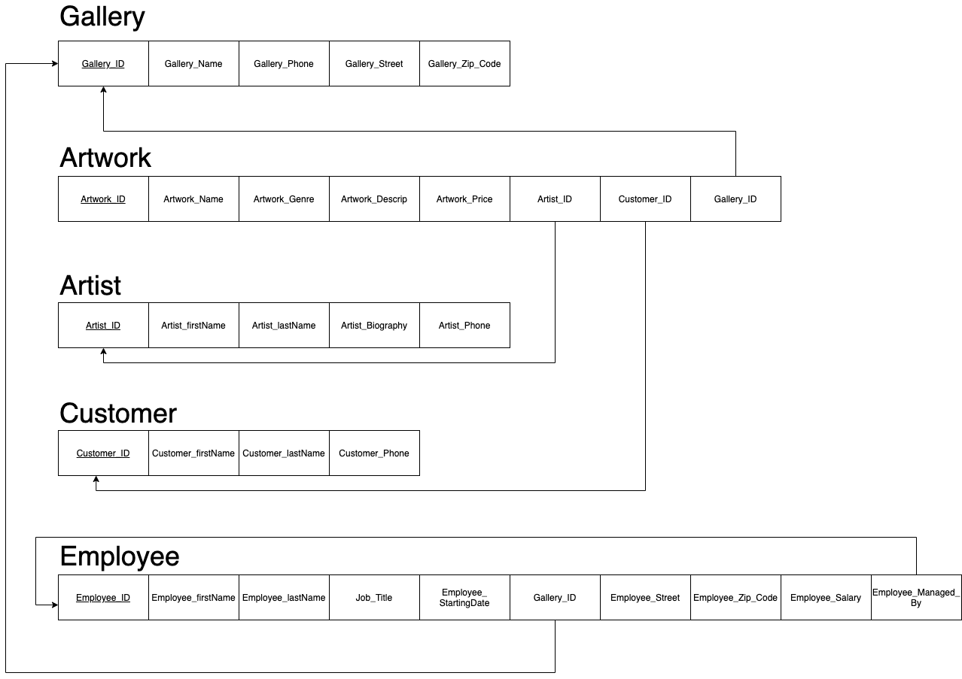
Schema Diagram

Slide 9
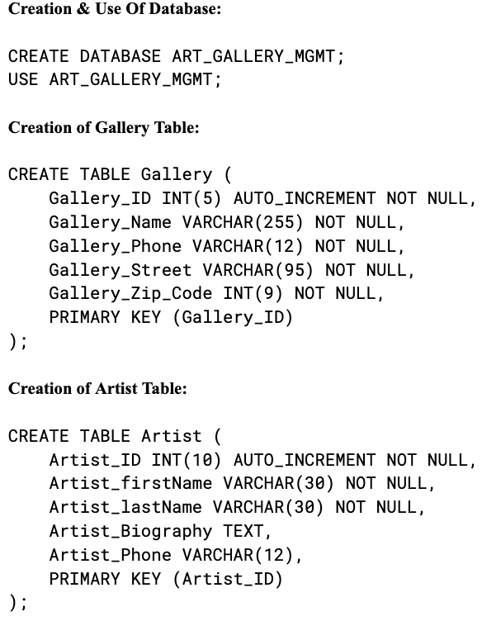
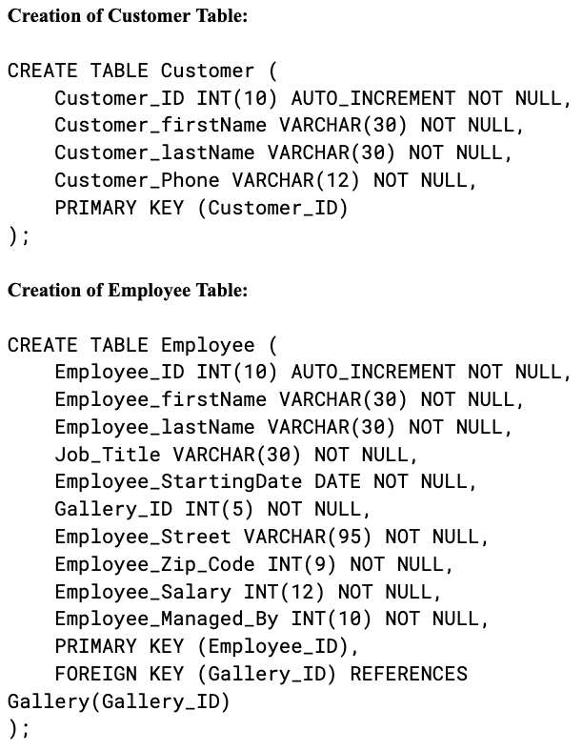
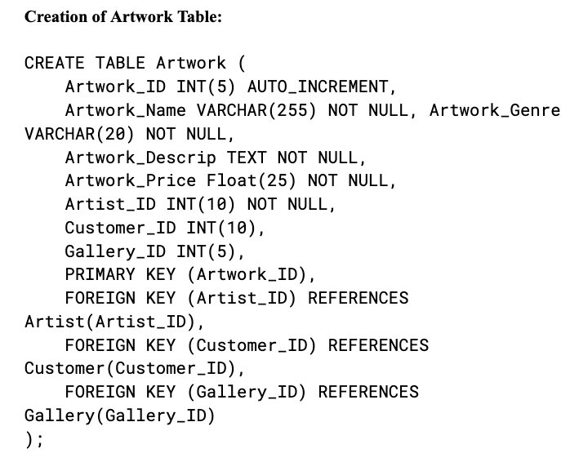
Creation of Database

Slide 10
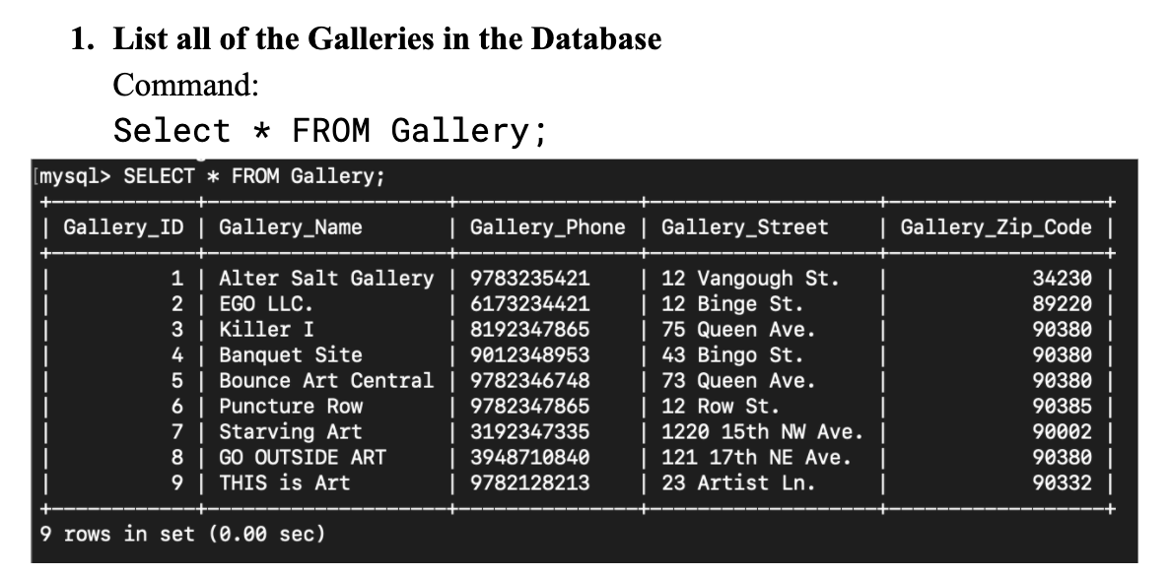
Test Query # 1

Slide 11
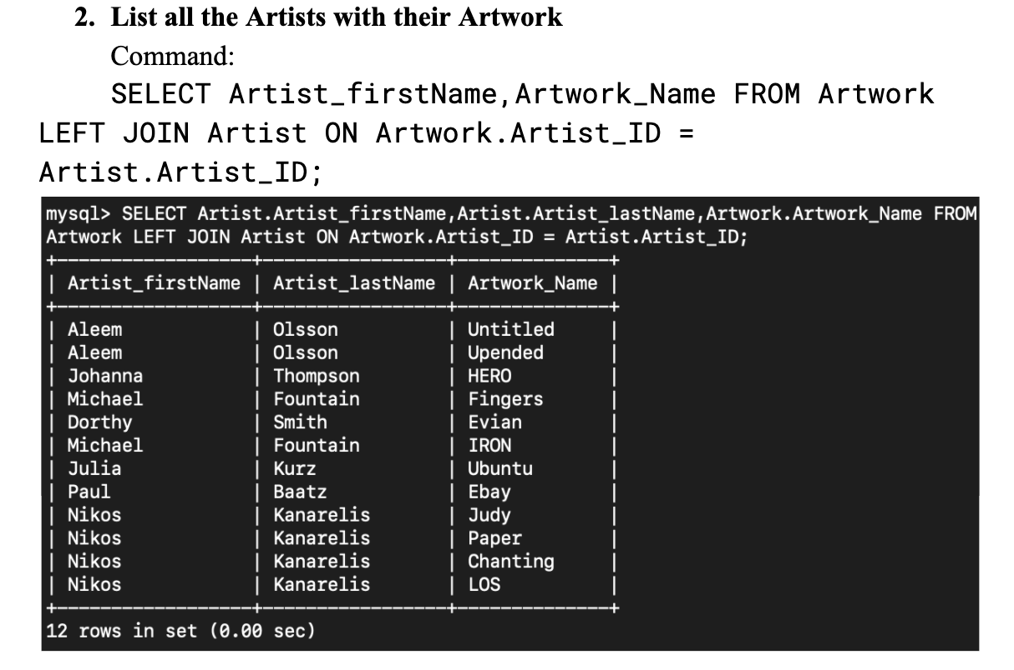
Test Query # 2

Slide 12
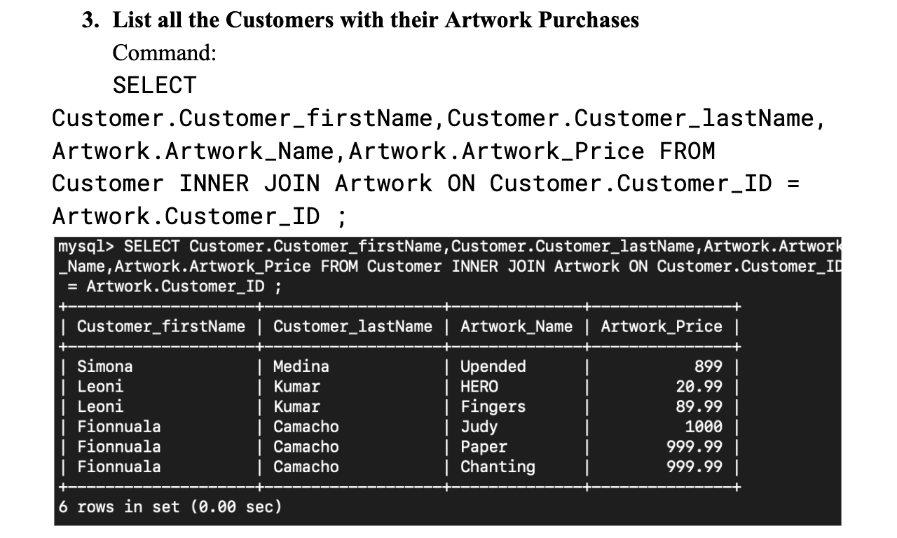
Test Query # 3

Slide 13
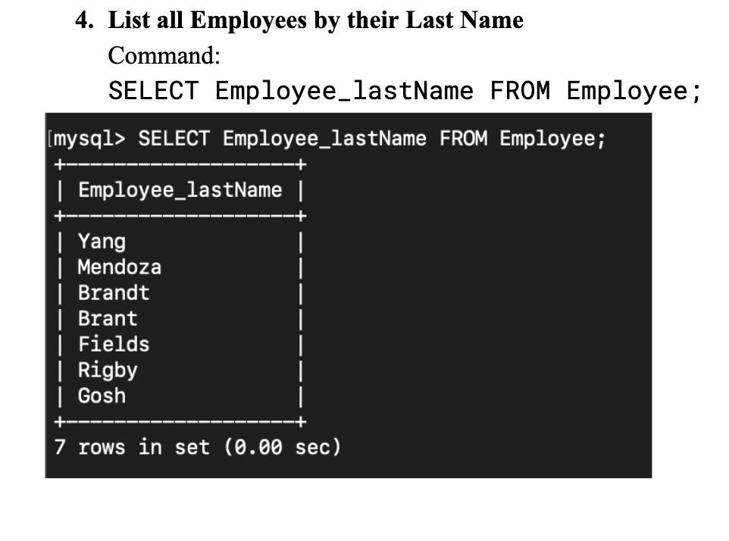
Test Query # 4

Slide 14
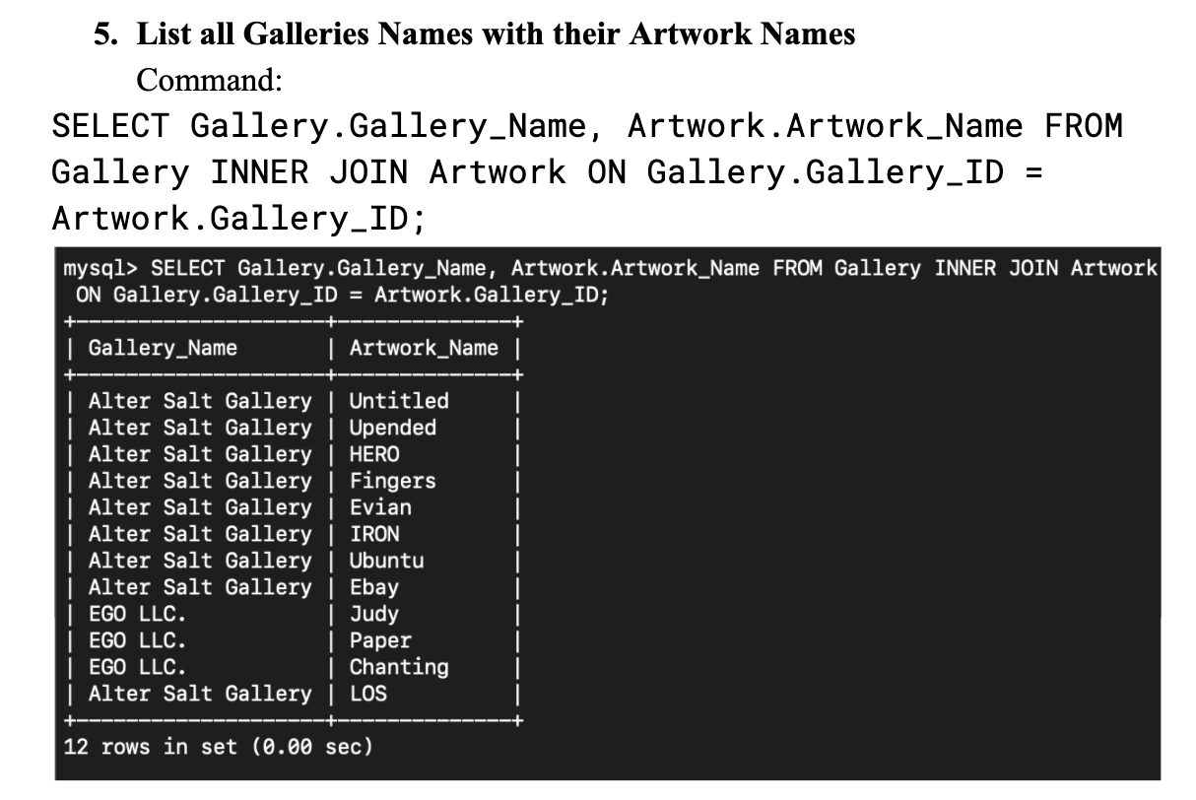
Test Query # 5

Slide 15
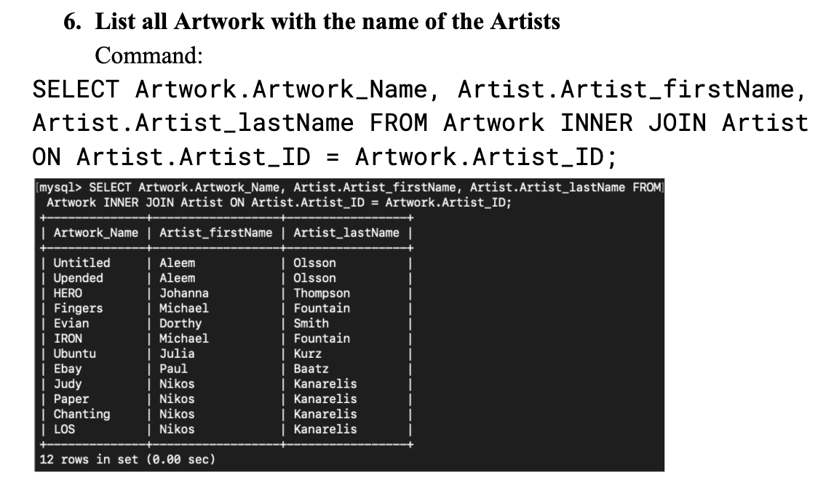
Test Query # 6

Slide 16
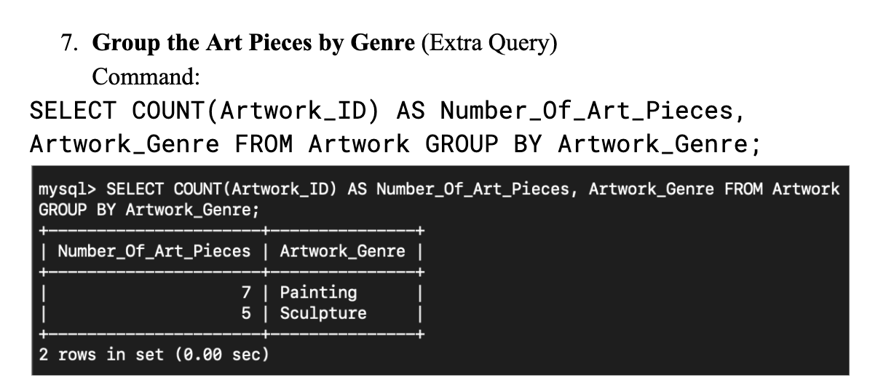
Test Query # 7

Slide 17
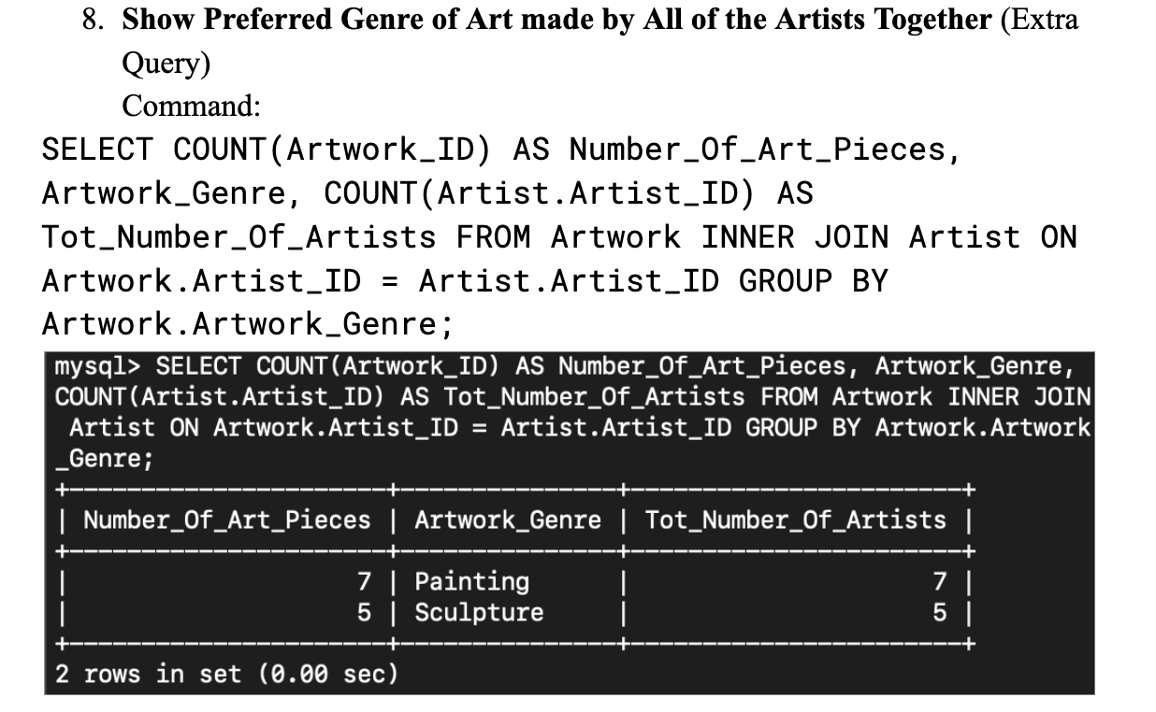
Test Query # 8

Slide 18
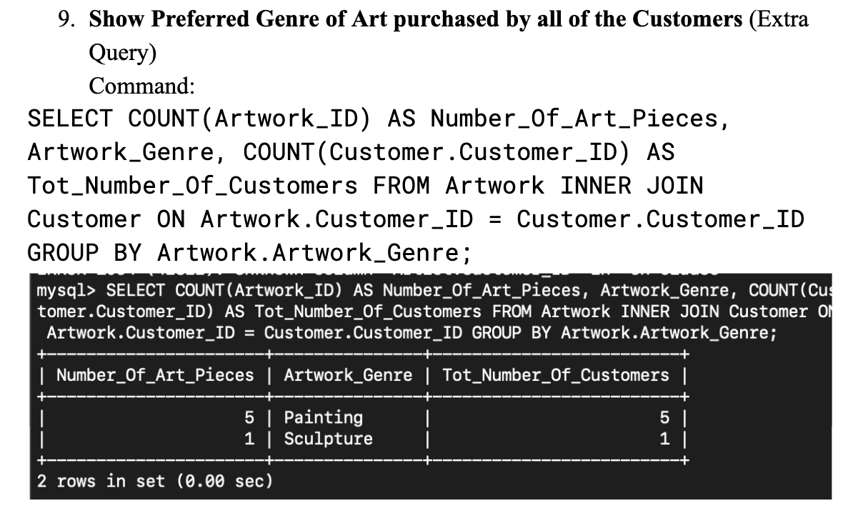
Test Query # 9

Slide 19
Conclusion (Abridged)
The MySQL Database to manage the Art Galleries were successfully executed after extensive planning.
It can be seen that the extensive planning did ensure that the Database System is actually useful and can be used to extract a lot of helpful and useful information.
Lastly this project was overall a success because it successfully created a system to help a group of Art Galleries to keep track of the Employees of each gallery and those who purchased (Customers) or created (Artists) the Artwork.

Slide 20
References
MySQL Documentation - https://dev.mysql.com/doc/
SQL section of W3Schools - https://www.w3schools.com/sql/
Fundamentals of Database Systems 7th Edition (Book)

